Slide 1
Disaster Recovery and Recurring Violence in Puerto Rico
26 November 2019

Slide 2
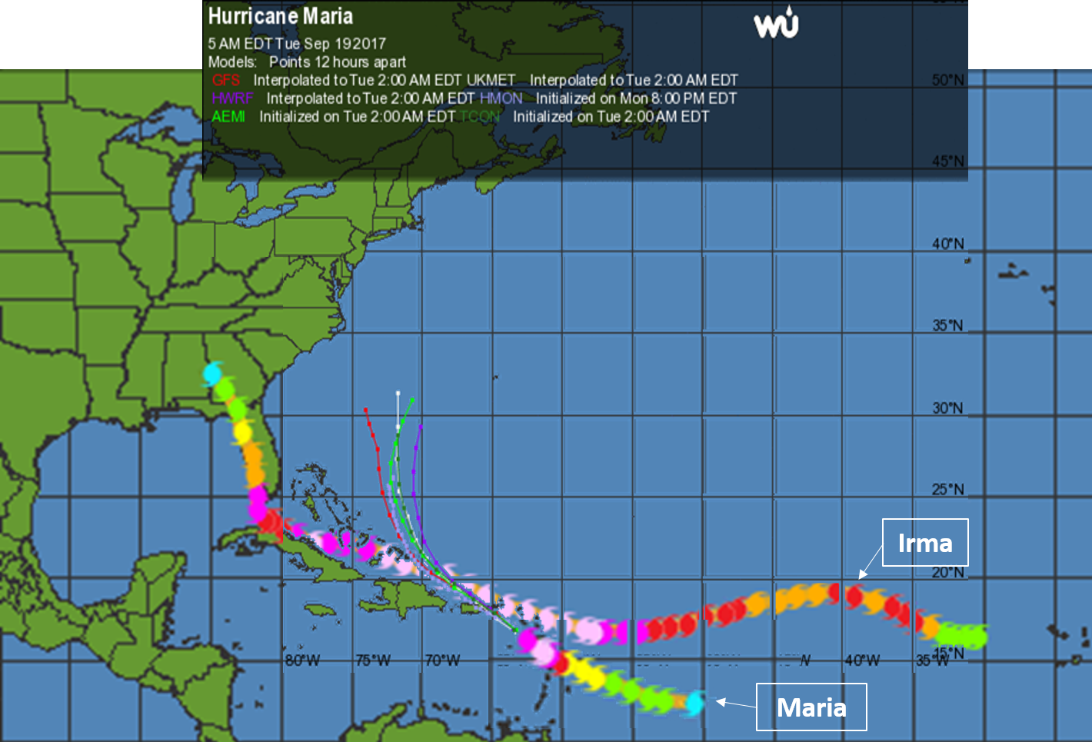
Hurricanes Irma and Maria
September 2017:

Slide 3
What were the storms’ impacts?
Garcia-Lopez 2018:
  Water supply?
  Energy supply?
  Air and water pollution?
  Food security?
NB: impacts are highly uneven
  Production of uneven exposure to premature death
  Amplified by failed response….

Slide 4
How did the US federal government response differ from aid to other states?
Speed of assistance?
Scale of assistance?
‘Geography’ of assistance?
  Ie, what spaces received aid and assistance fastest?

Slide 5
“Necropolitics” (Mbembe 2003)
Production of “death-spaces”
  Spaces where populations are exposed to violence, harm, environmental degradation
    Unlivable worlds
How does failed response produce an “unlivable world”?

Slide 6
Death toll controversy
Initial government claims: 64 deaths
Revised (Aug 2018): 2,975
Backdrop:
  NEJM study (May 2018): at least 4645 dead
    Locals estimate more…
Result of indirect impacts
  Exposure to premature death
    Lack electricity, medicine, mobility
    Lack water, food, sanitation
    Prone to disease

Slide 7
Recurring Violence of Disaster Impacts
Context: collapse of Puerto Rican ‘miracle’
  1948-1960s: Operation Bootstrap
    Rapid industrialization and economic growth
    Increase in wages, living conditions (still uneven)
  But: initial problems
    Increased reliance on food imports
    Enclave economy (early example of EPZ, Assembly)
    Assets: increasingly held by US investors
    Limited labor, environmental regulations
  1973/4: collapse of economy
    Contracted growth
    Rising unemployment

Slide 8
Recurring Violence of Disaster Impacts
Response to crisis
  Double down on investor-friendly policies
    Create ‘environment’ for investment
  Expansion of public sector (through 1990s)
    Compensate for unemployment in the private sector
  Increased government reliance on US funds, external loans
But…
  US funds, tax incentives evaporated (1990s)
  Government lost access to loans

Slide 9
Recurring Violence of Disaster Impacts
Result:
  2006 insolvency, public sector layoffs
  Early 2010s: effective sovereignty transferred to non-representative Financial Advisory Board
Vulnerability
  Limited investment in infrastructure
  Limited efforts to address food insecurity

Slide 10
Recurring Violence of Disaster Impacts
Post-Maria impacts:
  Continued effort to remake island for investor class
    Especially tech sector elites
  “Disaster capitalism” (Klein 2018)
    Disasters offer opportunities for enhanced profit, capital accumulation

